Slide 1
Coding Team 3-d
- Adnan, Muhammad - Component-based app development
- Arenas, Pedro – Security Implementation
- Ashar, Shazeem - Building a Frontend SPA for cross-usage
- Shahid, Arsalan – Building a Backend
- Ur Rehman, Mutee – HTML5, CSS3, ECMAScript2020

Slide 2
Table of Contents
Project Idea
Features
Must-have
Nice-to-have
Not-to-implement
Tech Stack
Architecture

Slide 3

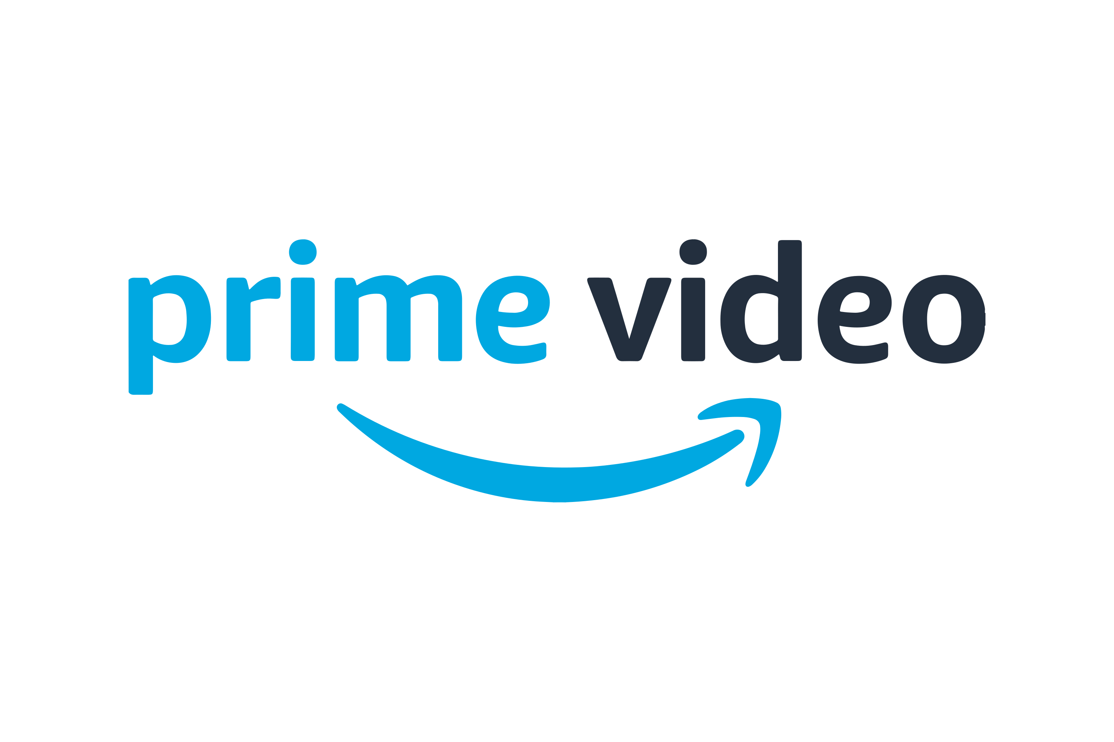

1. Project Idea
Today there are tones of streaming services and is hard for the users to follow all the content they are interested in
We want to provide a platform in which the user can have all the content unified and also stay tuned with notifications about seasons release dates, and much more.

Slide 4

Why not IMDb?
IMDb is property of Amazon
Have to pay to get some features (IMDb pro)
(It’s not a PWA)

Slide 5
2. Must-have features
Administrator Dashboard to upload the content.
Users can look for content by name, genre, platform, release date, etc without registering
Registered users can subscribe content to get notifications with news about it.

Slide 6
2. Nice-to-have features
User account dashboard to edit information like username, profile pic, update email, etc.
Reviews and opinions about content
Lists of content created by the user

Slide 7
2. Not-to-Implement features
Authentication with services like Amazon, Google, Facebook, Apple, etc
Integration with the content platforms
Including more type of content (Spotify, Youtube, Twitch streams, ...)
Playing content inside the platform

Slide 8

3. Tech Stack

Slide 9

3. Tech Stack

Slide 10

3. Tech Stack

Slide 11

3. Tech Stack

Slide 12

3. Tech Stack

Slide 13
3. Tech Stack
REST API

Slide 14

3. Tech Stack
REST API

Slide 15
4. Architecture
Admin Dashboard Frontend
Keycloak server
User Frontend
Admin Dashboard
User API
Db

Slide 16
4. Architecture
PWA
Admin Dashboard Frontend
Keycloak
Auth server
User Frontend
Admin Dashboard
User API
Db

